Slide 1
Interview Trainer Agent
CAPSTONE PROJECT
Presented By:
1. Manish Kumawat – SPSU Udaipur –CSE(FCI)

Slide 2
OUTLINE
Problem Statement
Proposed System/Solution
System Development Approach
Algorithm & Deployment
Result (Output Image)
Conclusion
Future Scope
References

Slide 3
Problem Statement
In today's competitive job market, effective interview preparation is a critical factor for success. However, a significant disconnect exists between the generic resources available to candidates
and the highly specific, role-based knowledge they are expected to demonstrate. This leads to several key challenges:
The Challenge: The modern hiring process is highly specialized, but candidates are often left with one-size-fits-all preparation materials that fail to address the unique demands of their target role.
The Gap: There is a lack of accessible, intelligent tools that can simulate a realistic interview by generating questions based on a candidate's individual resume, experience, and the specific position they are pursuing.
The Impact: This preparation gap leaves candidates feeling underprepared and unable to showcase their true qualifications, ultimately leading to lower confidence and a higher rate of rejection.

Slide 4
Proposed Solution
The proposed system aims to address the challenge of providing personalized and effective interview preparation for job seekers. This involves leveraging a powerful Large Language Model (LLM) with a Retrieval-Augmented Generation (RAG) framework to create a dynamic and intelligent conversational agent. The solution will consist of the following components:
AI Agent Core Functionality:
Implement a conversational AI, using an IBM Granite LLM, to understand user queries and provide detailed, context-aware responses.
The agent will be instructed via a system prompt to act as an expert Interview Trainer, personalizing the session based on the user's job role, experience level, and resume details.
RAG & Data Retrieval:
Integrate web search tools to enable the agent to retrieve real-time, role-specific information, such as common interview questions, industry expectations, and behavioral scenarios from various online sources.
This RAG approach ensures the generated questions are current and highly relevant, rather than being limited to the model's training data.
User Interaction & UI:
Develop a clean, modern, and user-friendly web chat interface using HTML, CSS, and JavaScript where users can interact with the agent.
The UI will support real-time streaming of the agent's responses and will correctly format text (bolding, lists) for improved readability.
Deployment & Architecture:
Deploy the agent as a secure API endpoint using IBM Cloud watsonx.ai.
Develop a Node.js proxy server to securely manage communication between the frontend and the IBM Cloud API.
Deploy the entire full-stack application to a scalable and reliable platform like Vercel for public accessibility.
Evaluation:
Assess the agent's performance based on the quality, relevance, and accuracy of the questions and model answers it generates.
Fine-tune the agent's core prompt based on user feedback to continuously improve the quality of the interview preparation session.

Slide 5
System Approach
This section outlines the overall strategy and the technical components required for developing and implementing the AI Interview Trainer Agent.
System Requirements
An IBM Cloud account with an active watsonx.ai service instance.
A Node.js environment for running the backend proxy server.
A modern web browser (like Chrome, Firefox, or Edge) for accessing the user interface.
A GitHub account for version control.
A Vercel account connected to GitHub for deployment.
Libraries & Technologies Required to Build the Project
Cloud & AI Services:
IBM Cloud & watsonx.ai Agent Lab
IBM Granite Series Foundation Model
Backend:
Node.js (Runtime Environment)
Express.js (Server Framework)
Axios (To make API requests to IBM Cloud)
Dotenv (For secure management of credentials)
CORS (To handle cross-origin requests)
Frontend:
HTML5
CSS3
JavaScript
Marked.js (A library to parse and display the agent's formatted responses)

Slide 6
Algorithm & Deployment
In this section, we describe the core AI logic and deployment strategy for the Interview Trainer Agent.
Algorithm Selection:
The project is built on an IBM Granite series Large Language Model (LLM). This model was chosen for its strong natural language understanding and generation capabilities, making it ideal for a dynamic, conversational task like conducting a practice interview. Instead of a predictive algorithm, it uses a generative approach guided by a detailed prompt.
Data Input:
The system utilizes two primary types of input:
Direct User Input: The user provides their target job role, years of experience, and can paste the text of their resume.
Retrieved Web Data: The agent uses integrated search tools (Retrieval-Augmented Generation - RAG) to fetch real-time data from the web, such as common questions for that role and relevant industry expectations.
"Training" Process (Prompt Engineering):
Unlike traditional models, the agent isn't "trained" on a static dataset. Instead, its behavior is guided in real-time through Prompt Engineering.
A detailed system prompt was crafted to instruct the agent on its persona (an expert Interview Trainer), its goals (to help users prepare), and its workflow (ask for details, generate questions, provide model answers, and give tips).
"Prediction" Process (Response Generation):
When a user sends a message, their input is combined with the system prompt and the data retrieved from the web (RAG).
The IBM Granite LLM processes this combined information to generate a relevant, context-aware response.
The output (the tailored interview questions, answers, and tips) is sent back to the user interface as a continuous stream of text for a real-time, conversational feel.

Slide 7
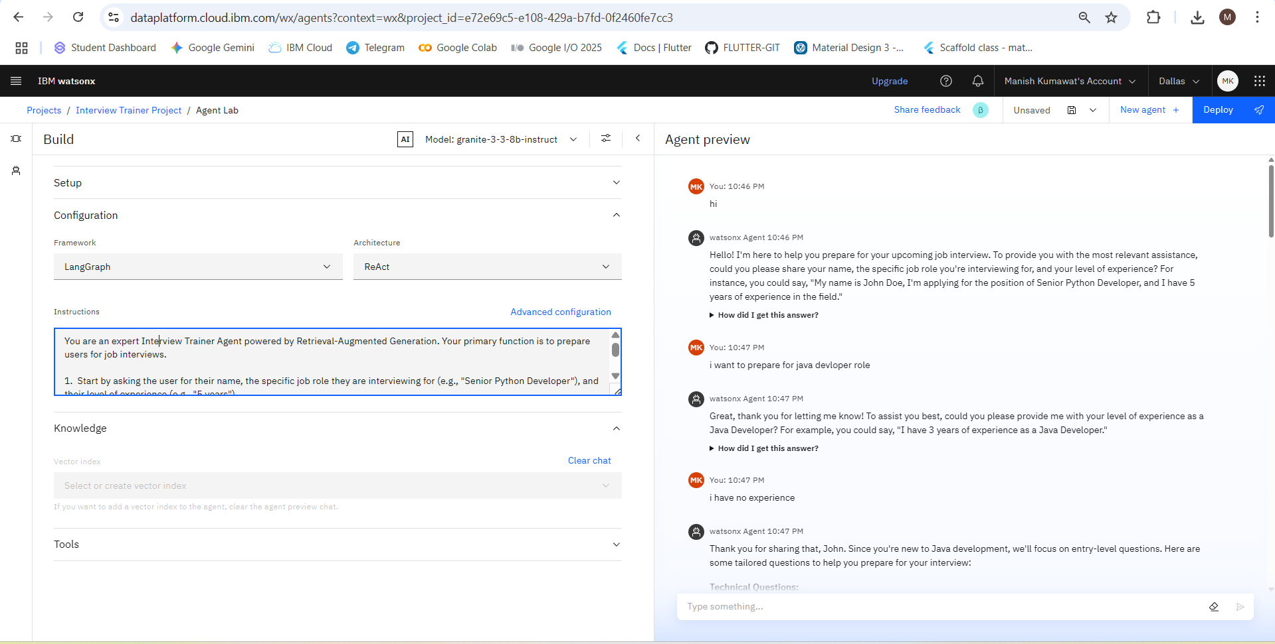
Result
RESULT OF IBM CLOUD WATSONX INTERVIEW AGENT

Slide 8
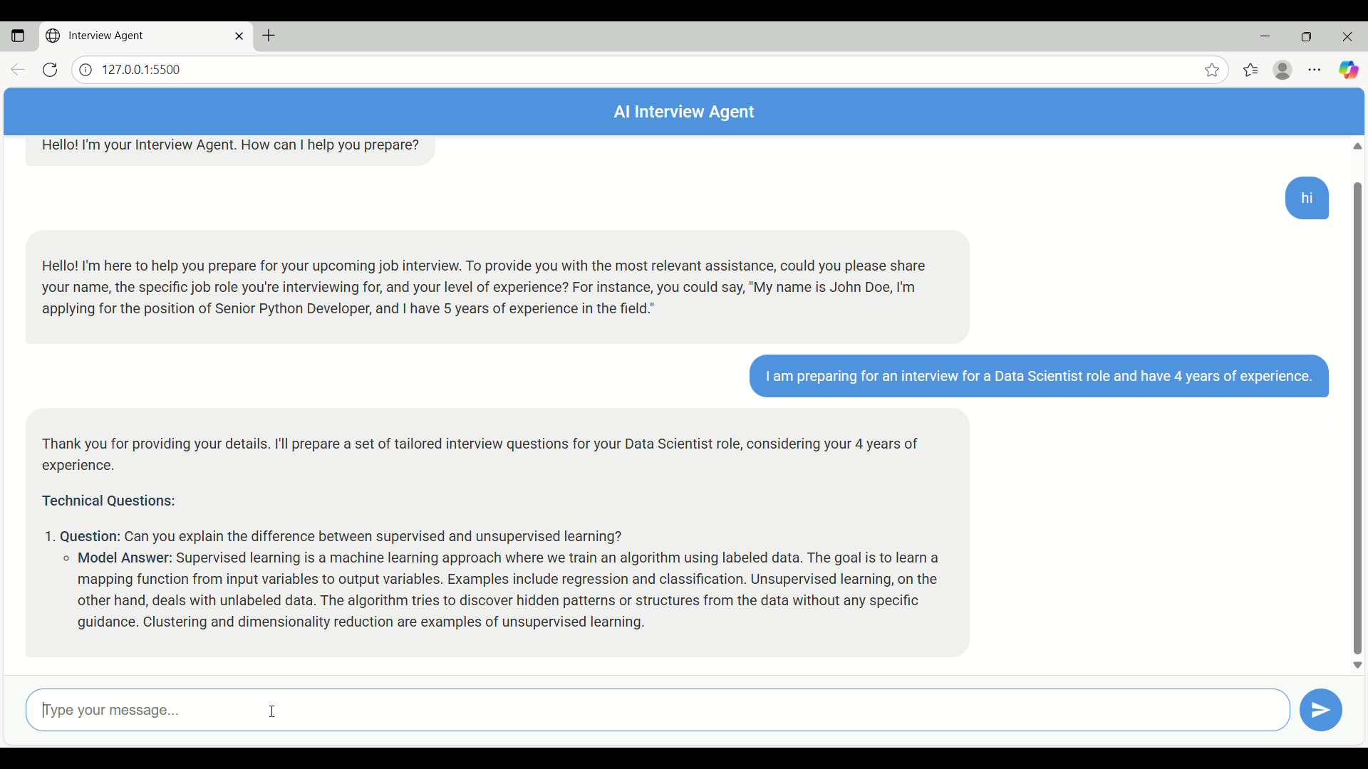
Result
RESULT OF LOCAL DEPLOYMENT WITH UI (FRONTEND AND BACKEND)
Live Deployment link : https://interview-trainer-agent.vercel.app/

Slide 9
Conclusion
The AI Interview Agent project successfully resulted in a functional, full-stack application that directly solves a key problem for job seekers.The agent proved highly effective at generating personalized, relevant interview questions in a dynamic, conversational manner, fulfilling the core objectives of the project.
Significant technical challenges were overcome during implementation. These included resolving CORS security policies by building a Node.js proxy, debugging the streaming data response from the LLM to ensure proper display.
The development of the AI Interview Agent highlights the immense value of personalized, AI-driven tools in modern career preparation. By offering on-demand and tailored practice, this solution can directly boost a candidate's confidence, sharpen their responses, and improve their chances of success in the competitive job market.

Slide 10
Future scope
Direct Resume Upload: Enhance the system to allow users to directly upload their resume as a PDF or DOCX file, creating a more seamless user experience.
Voice Interaction: Integrate speech-to-text and text-to-speech capabilities to simulate a more realistic, verbal interview. This would allow users to practice speaking their answers and get accustomed to the flow of a real conversation.
Feedback on User Answers: Advance the agent's capabilities to analyze the user's responses. The AI could provide feedback on clarity, conciseness, keyword usage, and whether the answer effectively uses frameworks like the STAR method.
Company-Specific Research: Add a feature where the user can input the company they are interviewing with. The agent could then perform targeted research to tailor questions based on the company's culture, recent news, and specific job requirements.
Session History and Analytics: Implement user accounts to save and review past interview sessions. This would allow users to track their progress, identify areas of weakness, and see their improvement over time.

Slide 11
References
IBM Cloud and watsonx.ai Documentation : Referenced for creating, configuring, and deploying the core AI agent and managing cloud services
Node.js and Express.js Documentation: Referenced for building the backend proxy server to handle API requests and manage CORS policies.

Slide 12
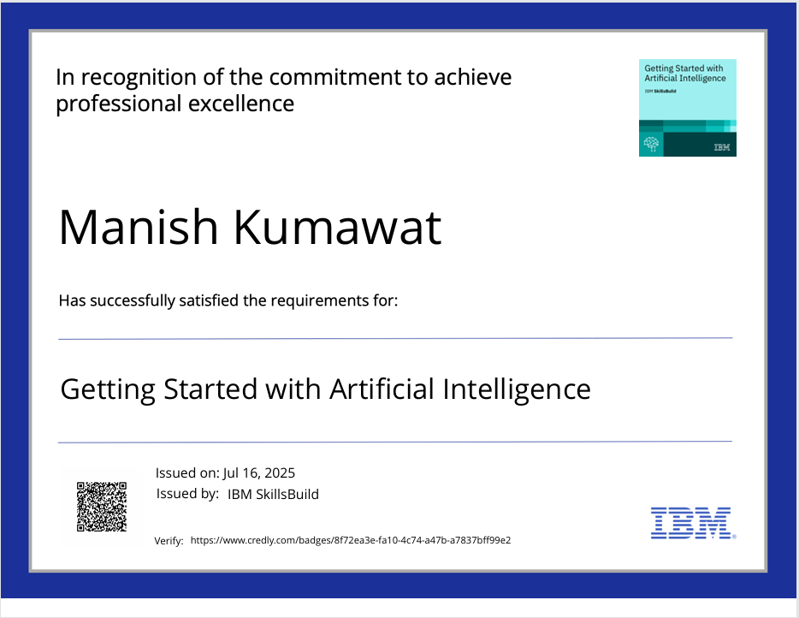
IBM Certifications

Slide 13
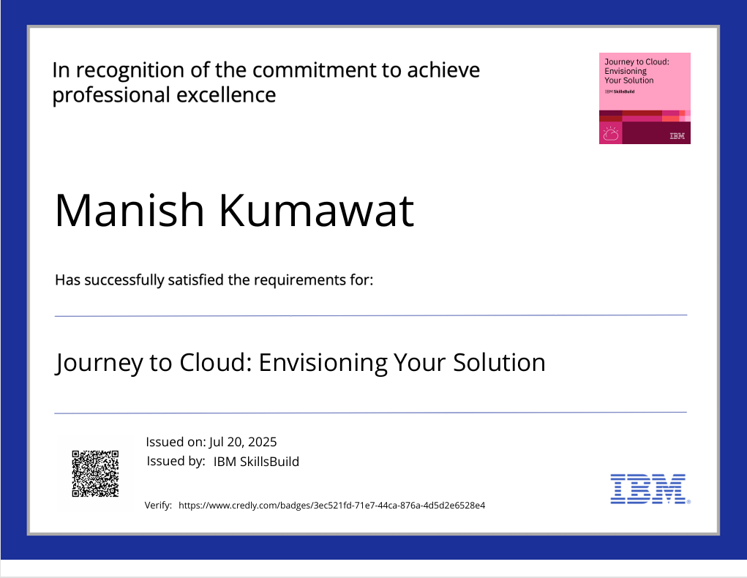
IBM Certifications

Slide 14
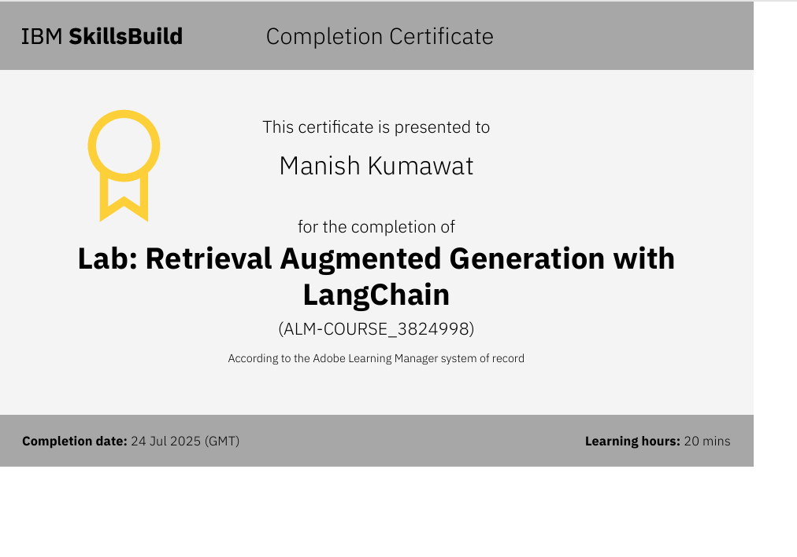
IBM Certifications

Slide 15
THANK YOU

